Slide 1
Minor Project - II

Slide 2
ReuseU
Submitted to the department of Computer Science and Engineering in partial fulfillment of the requirement for the Bachelor of Technology 6th Semester

Slide 3
Problem Statement
There is a lack of a convenient and efficient platform for students to buy or sell old educational materials within the inter-college community. Current options, such as physical bulletin boards or online classifieds, are often disorganized, time-consuming, and limited in reach. Additionally, there may be security concerns when dealing with individual buyers or sellers, as well as the lack of user-friendly interface tailored specifically to the needs of college students.

Slide 4
Solution
The proposed system is an inter-college Full Stack e-commerce website that aims to revolutionize the way students buy or sell old educational materials. This website will provide a comprehensive and user-friendly platform exclusively for college students, addressing the limitations of the existing system.
The proposed system will feature a modern and intuitive interface that makes it easy for students to navigate and find the educational materials they need. Students can create detailed listings for their items, including information such as subject, condition, price, and contact details, to provide a comprehensive overview for potential buyers. The website will also incorporate robust security measures, such as encrypted communication and secure payment gateways, to ensure safe transactions between buyers and sellers. One of the unique aspects of the proposed system is its focus on the inter-college community. Students from different colleges can connect and collaborate within a trusted and exclusive environment. Additionally, the proposed system will offer advanced search and filter options, allowing students to easily search for educational materials based on subject, price range, and location, making it efficient to find the specific items they are looking for. By providing a centralized and user-friendly platform, the proposed system will streamline the process of buying or selling old educational materials among college students. It will offer a secure, convenient, and efficient solution, eliminating the limitations of the existing system and enhancing the overall experience for students looking to buy or sell old educational materials within their inter-college community.

Slide 5
Uniqueness
The unique aspects of the proposed system is its focus on the inter-college community. Students from different colleges can connect and collaborate within a trusted and exclusive environment. The website may include features such as college-specific forums or chat options, allowing students to interact, share resources, and build a sense of community.

Slide 6






Technology Stack
Mongo DB
React.js
Material UI
Node.js
Expressjs

Slide 7
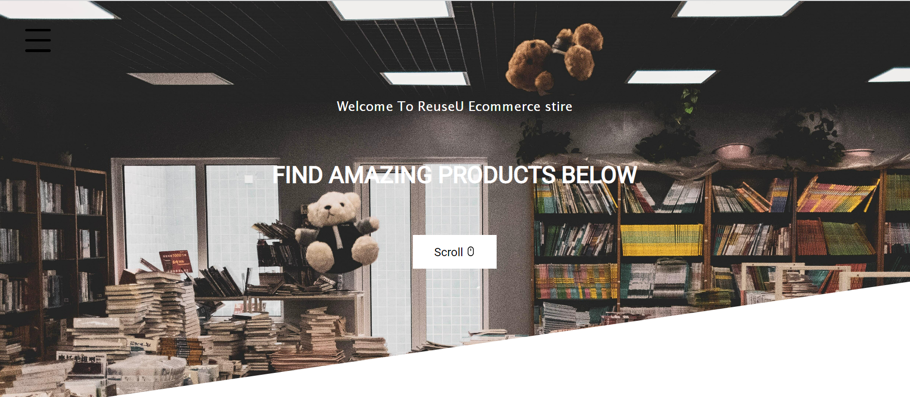
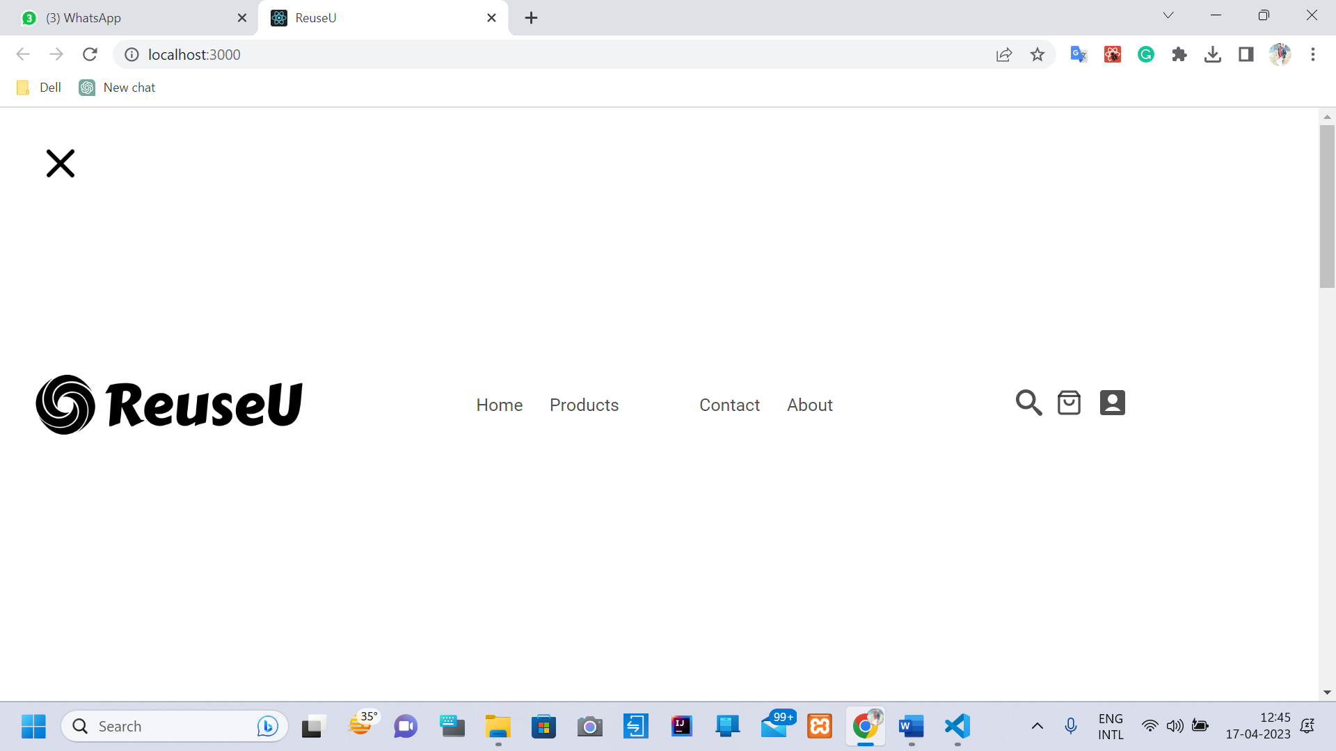
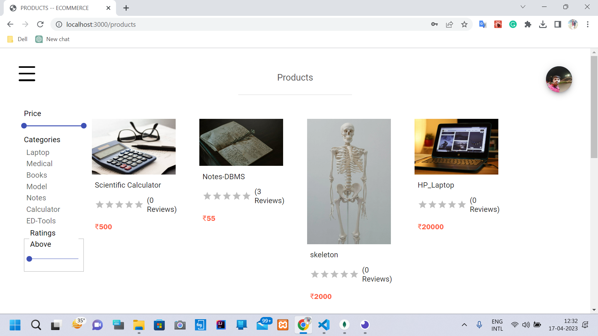
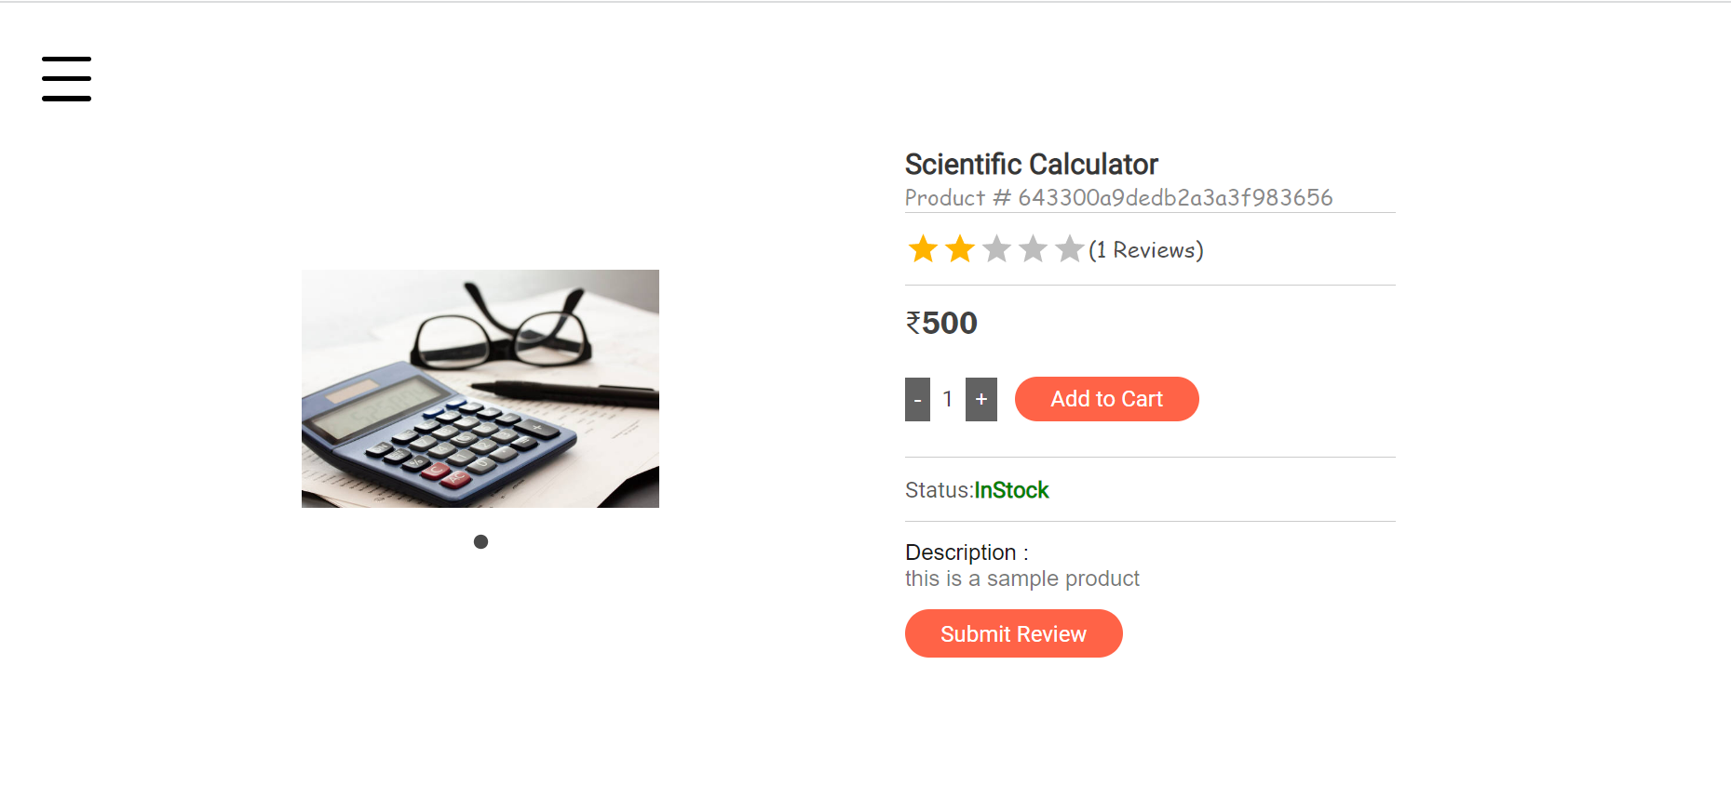
GUI

Slide 8
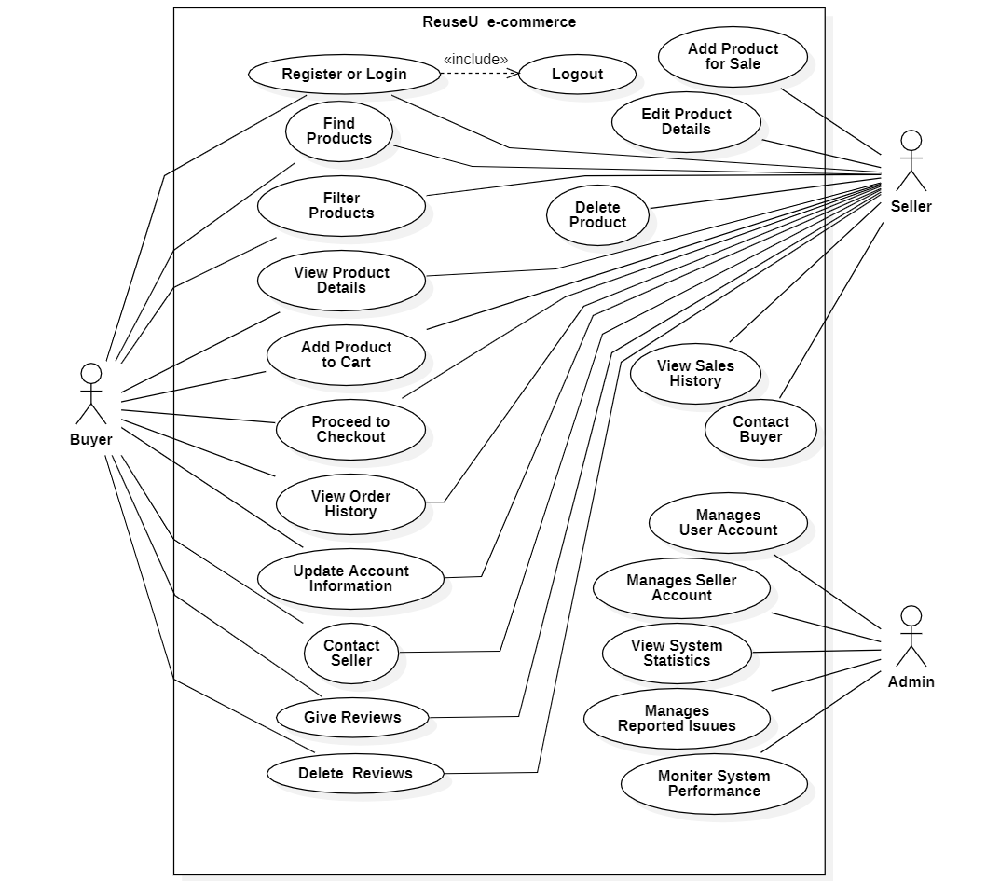
UseCase Diagram

Slide 9
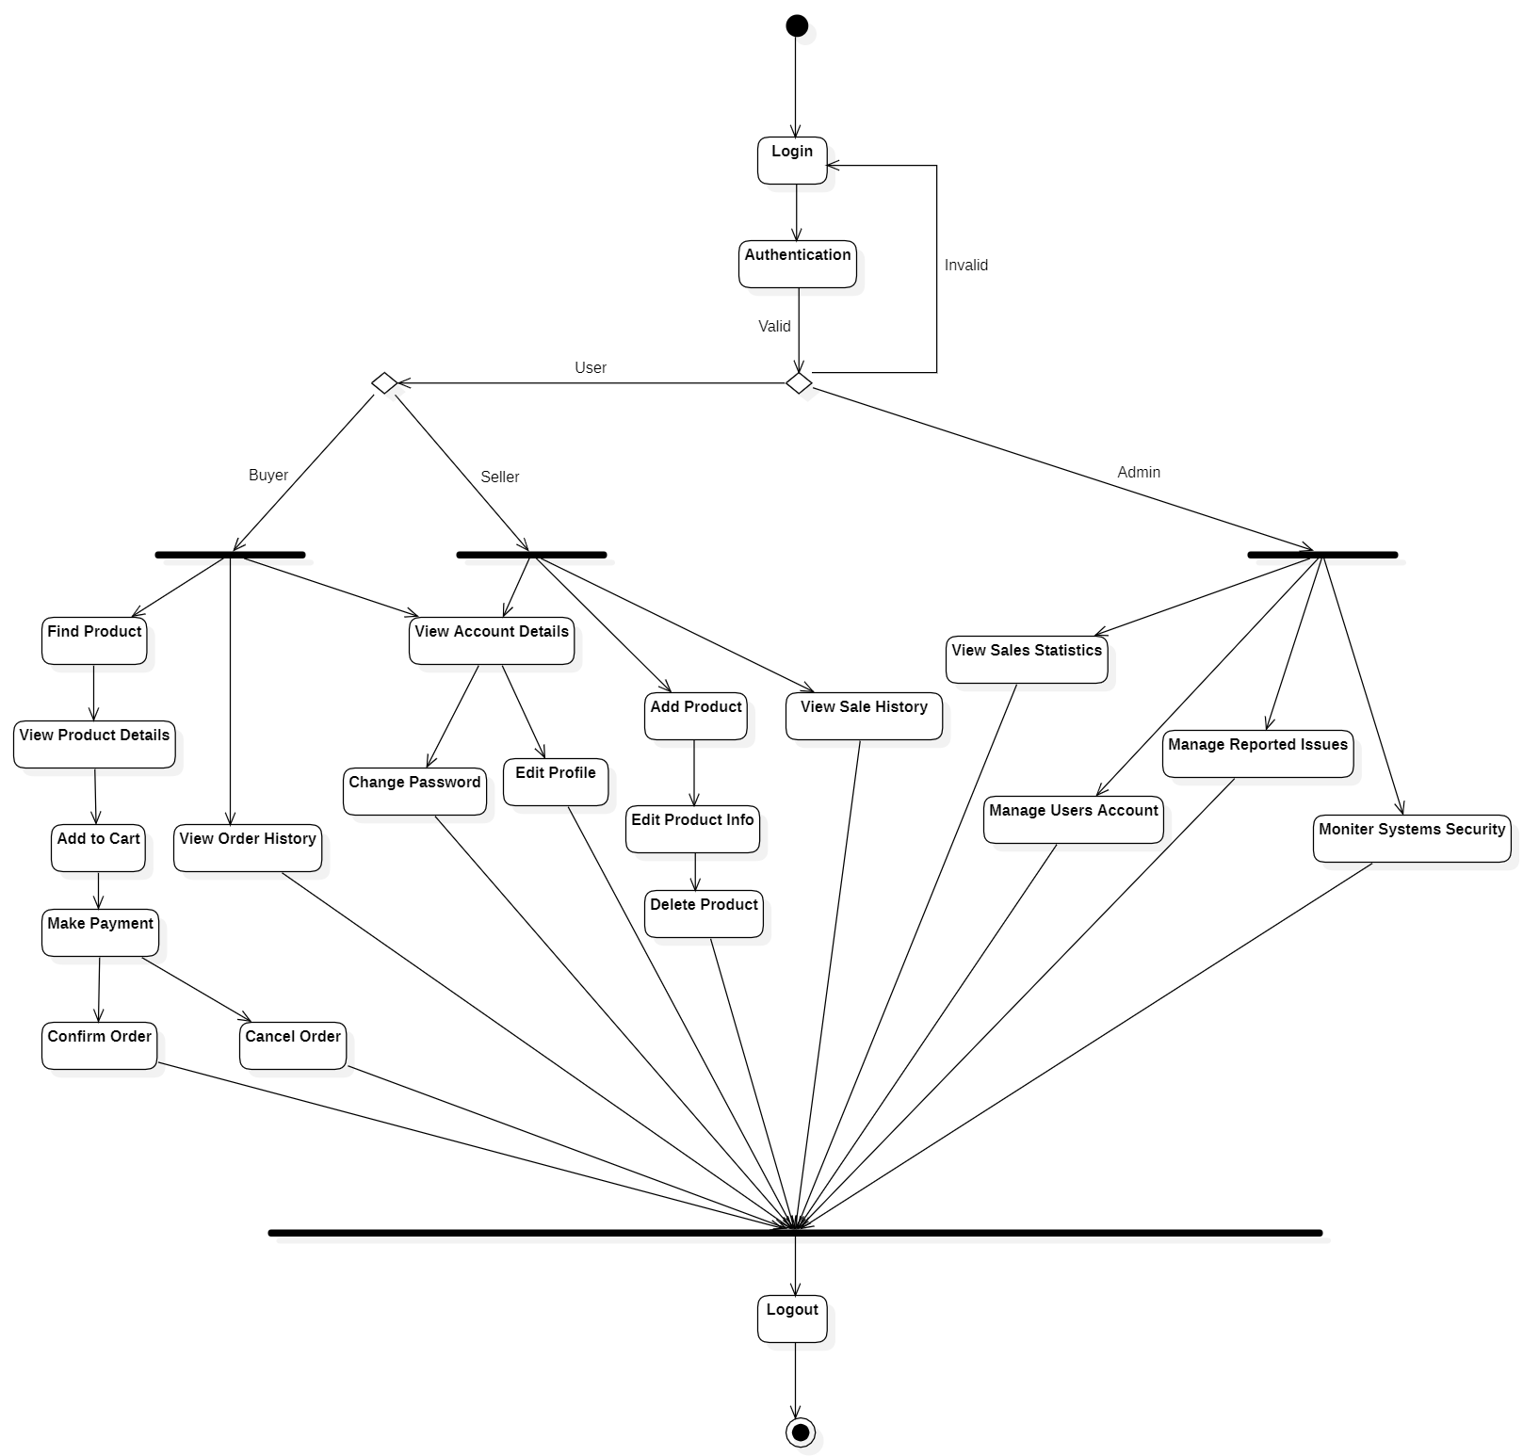
Activity Diagram

Slide 10
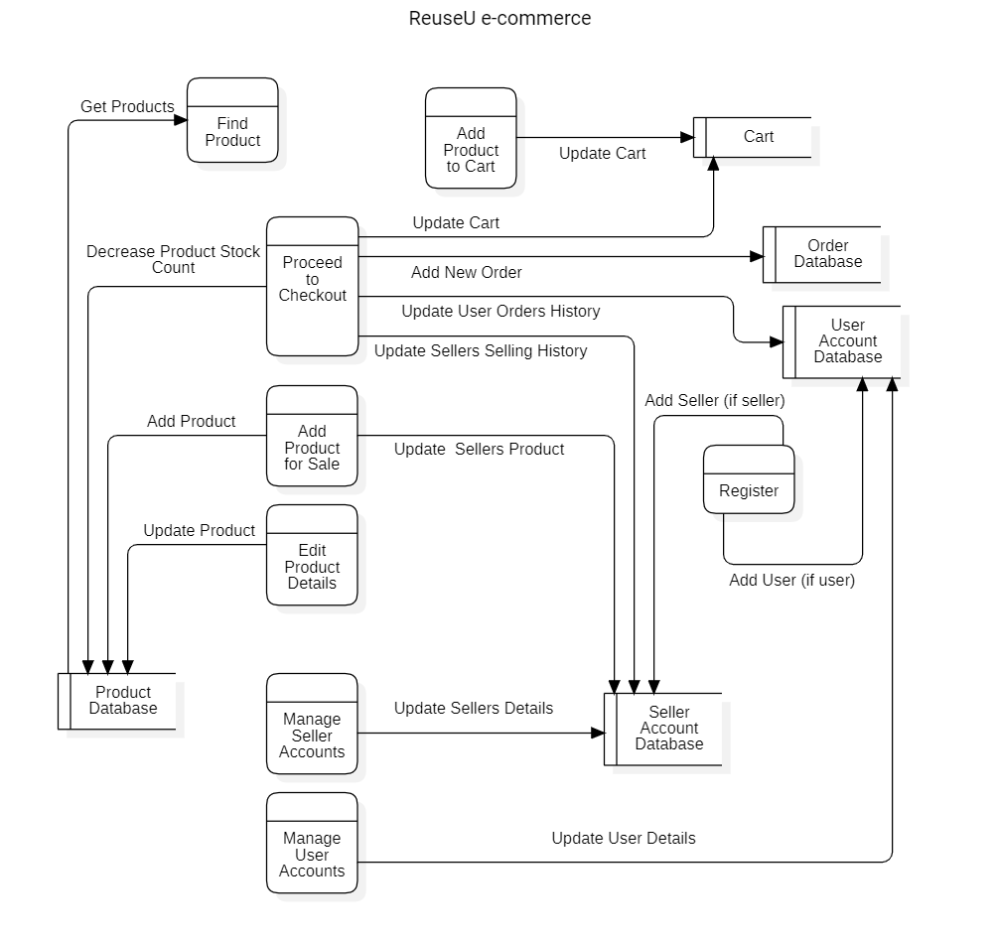
Data Flow Diagram

Slide 11
Team Details
Team Guide : Prof. Kamaljeet Singh Kalsi
Team Leader : Ayush Patel
Team Members : Josh Kumar
Abhishek Vishwakarma
Mohit Kanojia

Slide 12
Thank You

